Slide 1
Chapter 5
Classless Addressing

Slide 2
Outline
Variable-Length Blocks
Subnetting
Address Allocation

Slide 3
Classless Addressing
Classful addressing has created many problems
Solution: classless addressing
Proposed in 1996 and will eventually render classful addressing obsolete
Idea: variable-length blocks

Slide 4

5.1
Variable-Length
Blocks
The McGraw-Hill Companies, Inc., 2000

Slide 5
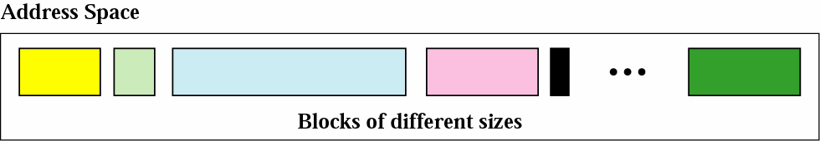
Variable-Length Blocks
□ The whole address space (2^32 addresses) is divided into blocks of different sizes

Slide 6
Restrictions
Number of Addresses in a Block
The number of addresses in a block must be a power of 2 (2, 4, 8, . . .)
Beginning Addresses
The beginning address must be evenly divisible by the number of addresses.
Ex: if a block contains 4 addresses, the beginning address must be divisible by 4.
Make the rightmost number of bits in the beginning address are zero
If the block has less than 256 addresses, we need to check only the rightmost byte.
If it has less than 65,536 addresses, we need to check only the two rightmost bytes, and so on.

Slide 7
Example 1
Which of the following can be the beginning address of a
block that contains 16 addresses?
205.16.37.32
190.16.42.44
17.17.33.80
123.45.24.52
Solution
The address 205.16.37.32 is eligible because 32 is divisible by 16. The address 17.17.33.80 is eligible because 80 is divisible by 16.
The McGraw-Hill Companies, Inc., 2000

Slide 8
Example 2
Which of the following can be the beginning address of a
block that contains 256 addresses?
205.16.37.32
190.16.42.0
17.17.32.0
123.45.24.52
Solution
When the right-most byte is 0, the total address is divisible by 256. Only two addresses are eligible (b and c).
The McGraw-Hill Companies, Inc., 2000

Slide 9
Example 3
Which of the following can be the beginning address of a
block that contains 1024 addresses?
205.16.37.32
190.16.42.0
17.17.32.0
123.45.24.52
Solution
To be divisible by 1024, the rightmost byte of an address should be 0 and the second rightmost byte must be divisible by 4. Only the address 17.17.32.0 meets this condition.
The McGraw-Hill Companies, Inc., 2000

Slide 10
Mask
In classful addressing, the mask is implicit
The mask for a class A block is 255.0.0.0 (/8)
However, in classless addressing
When an address is given, we must also have its mask to know the its belonging block
Thus, the address must be accompanied by the mask
Use the CIDR notation with the number of 1s in the mask

Slide 11
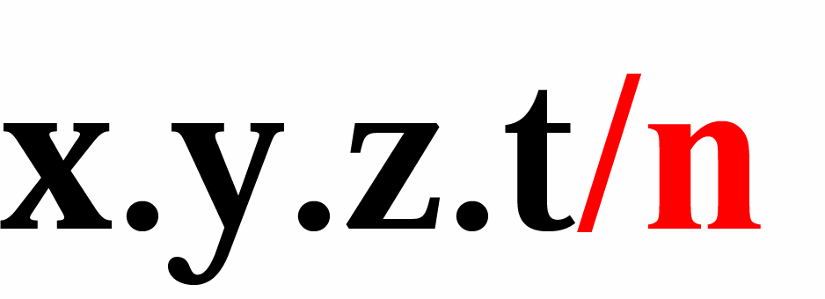
CIDR Notation
CIDR (Classless InterDomain Routing)
Attach the number of common bits in every address in the block to the end of a classless address
i.e., the number of 1s in a mask

Slide 12
Prefix and Suffix
Prefix
Another name for the common part of the address range
Similar to the netid
Prefix length: the length of the prefix
Equal to n in the slash notation
Similar to the hostid
Suffix
The varying part of the address range
Suffix length: the length of the suffix
Equal to (32-n) in slash notation

Slide 13
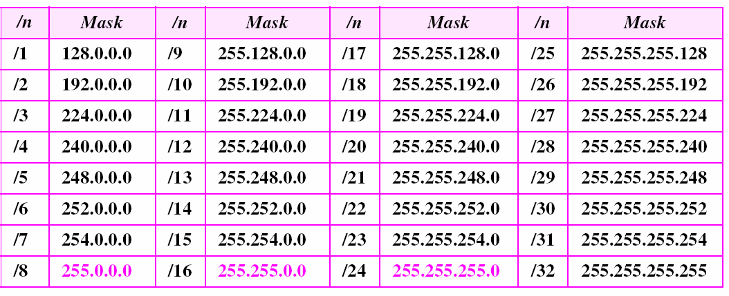
Prefix Lengths
Classful addressing is a special case of classless addressing.

Slide 14
Finding the Block
When a classless address is given, we can find the block
The first address in the block
The number of addressed in the block
The last address in the block

Slide 15
Finding the First Address
We can derive the first address if we know
One of the address in the block
The prefix length, or a mask, or the suffix length
Solution 1
AND the mask and the address to find the first address, i.e., network address
Solution 2
Just keep the first n bits and change the rest to 0s

Slide 16
Example 4
What is the network address if one of the addresses is 167.199.170.82/27?
The McGraw-Hill Companies, Inc., 2000

Slide 17
Solution
The prefix length is 27
We must keep the first 27 bits as it is and change the remaining bits (5) to 0s.
The 5 bits affect only the last byte.
The last byte is 01010010.
Changing the last 5 bits to 0s, we get 01000000 or 64.
The network address is 167.199.170.64/27.

Slide 18
First Short Cut to Find the First Address
Divide the prefix length into four groups and find the number of 1s in each group
If the number of 1s in a group is 8
The corresponding byte in the first address is the same
If the number of 1s in a group is zero
The corresponding byte in the first address is 0
If the number of 1s in a group is between zero and eight
Keep the corresponding bits in that group

Slide 19
Example 5
What is the first address in the block if one of the addresses is 140.120.84.24/20?
Solution
The first, second, and fourth bytes are easy;
for the third byte we keep the bits corresponding to the number of 1s in that group.
The first address is 140.120.80.0/20.
See next slide

Slide 20
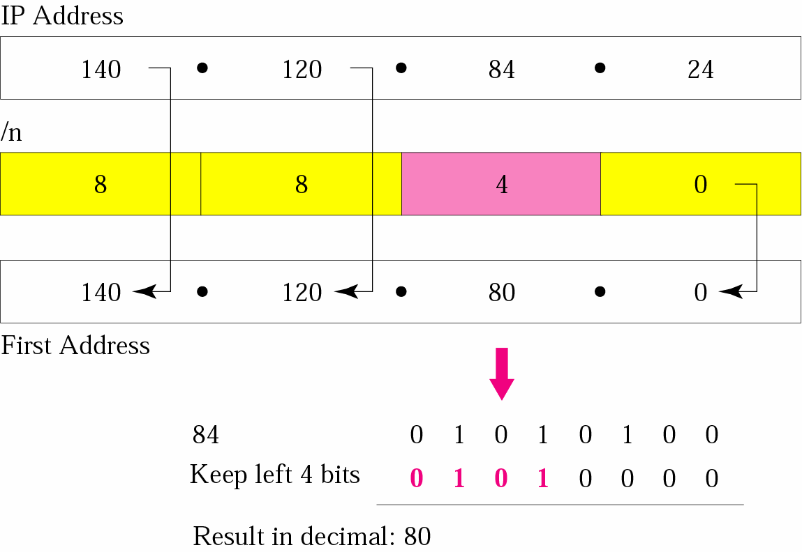
Example 5

Slide 21
Second Short Cut to Find the First Address
To avoid using binary numbers
Write the byte in the address as a sum of powers of 2
If a power is missing, insert 0
Then choose the m highest powers
m = corresponding number in the prefix length

Slide 22
Example 6
Find the first address in the block if one of the addresses is 140.120.84.24/20.
Solution
The first, second, and fourth bytes are as defined in the previous example.
To find the third byte,
Write 84 as the sum of powers of 2
Select only the leftmost 4 (m is 4)
The first address is 140.120.80.0/20
See next slide

Slide 23
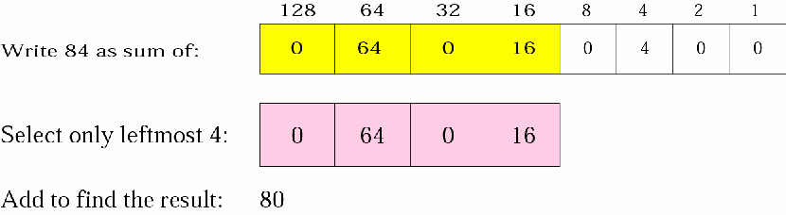
Example 6

Slide 24
Finding the Number of Addresses in the Block
□ The total number of addresses in the block is ₂32-n

Slide 25
Example 7
Find the number of addresses in the block if one of the addresses is 140.120.84.24/20
Solution
The prefix length is 20.
The number of addresses in the block is 232−20 or 212 or 4096.

Slide 26
Finding the Last Address in the Block
Two methods
First method
Add the number of addresses in the block minus 1 to the first address
Second method
Add the first address to the complement of the mask

Slide 27
Example 8
Using the first method, find the last address in the block if one of the addresses is 140.120.84.24/20.
Solution
We found in the example 7
The first address is 140.120.80.0/20
The number of addresses is 4096.
To find the last address
Add 4095 (4096 − 1) to the first address.
See next slide

Slide 28
Example 8 (Cont.)
To keep the format in dotted-decimal notation,
Represent 4095 in base 256
Write 4095 as 15.255.
We then add the first address to this number to obtain the last address
140 . 120 . 80 . 0
15 . 255
------------------------- 140 . 120 . 95 . 255
The last address is 140.120.95.255/20.

Slide 29
Example 9
Using the second method, find the last address in the block if one of the addresses is 140.120.84.24/20.
Solution
The mask has twenty 1s and twelve 0s.
□ The complement of the mask has twenty 0s and twelve 1s. In other words, the mask complement is
00000000 00000000 00001111 11111111
or 0.0.15.255

Slide 30
Example 9 (Cont.)
□ We add the mask complement to the beginning address to find the last address
140 . 120 . 80 . 0
0 . 0 . 15 . 255
---------------------------- 140 . 120 . 95 . 255
The last address is 140.120.95.255/20.

Slide 31
Example 10
Find the block if one of the addresses is 190.87.140.202/29
Solution: follow the procedure in the previous examples to find
The first address
The first address is 190.87.140.200/29
The number of addresses
The number of addresses is 2^(32−29) or 8
The last address.
□ the last address is 190.87.140.207/20

Slide 32
Example 11
Show a network configuration for the block in the previous example
Solution
The organization can assign the addresses in the block to the hosts in its network.
However, the first address needs to be used as the network address and the last address is kept as a special address (limited broadcast address).
Following figure shows how the block can be used by an organization.
Note that the last address ends with 207, which is different from the 255 seen in classful addressing

Slide 33
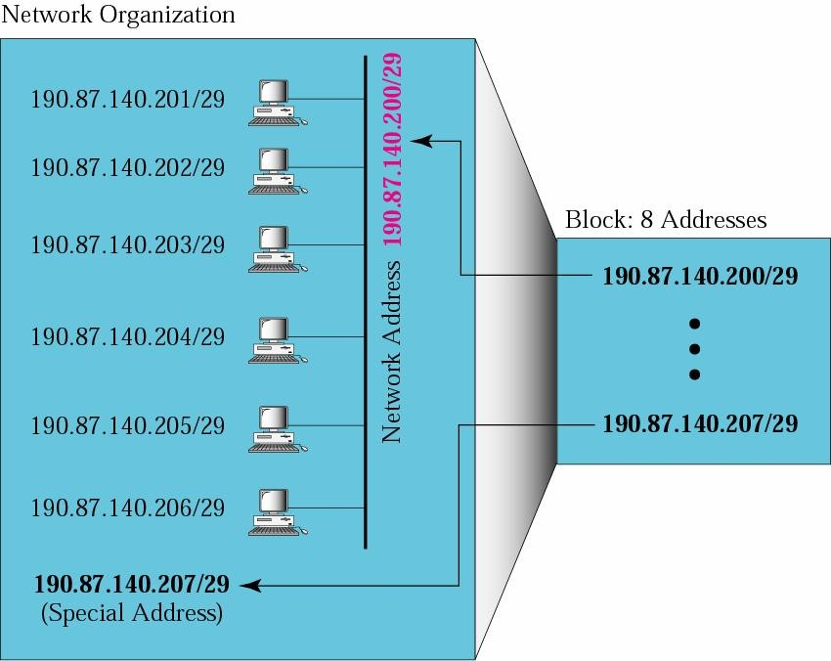
Example 11

Slide 34
Granted Block
A granted block to an ISP is defined by
The first address
The prefix length
CIDR notation totally determines the block
E.g., the block in previous example is defined as 190.87.140.200/29

Slide 35
Note
In classless addressing, the last address in the block does not necessarily end in 255.
In CIDR notation, the block granted is defined by the first address and the prefix length.

Slide 36
5.2
Subnetting
The McGraw-Hill Companies, Inc., 2000

Slide 37
Subnetting
We can also use subnetting with classless addressing
Just increase the prefix length to derive the subnet prefix length
See the following example.

Slide 38
Finding the Subnet Mask
Subnet prefix
Defined by the number of desired subnets
If the number of subnets is s
The number of extra 1s in the prefix length is log₂s
If we want fixed-length subnets
Each subnet has the same number of addresses
The number of subnets needs to be a power of 2
In fixed-length subnetting, the number of subnets is a power of 2.

Slide 39
Example 12
An organization is granted the block 130.34.12.64/26.
The organization needs 4 subnets.
What is the subnet prefix length?
Solution
We need 4 subnets
□ We need to add two more 1s (log2 4 = 2) to the site prefix.
The subnet prefix is then /28

Slide 40
Example 13
What are the subnet addresses and the range of addresses for each subnet in the previous example?
Solution
The site has 232−26 = 64 addresses.
Each subnet has 232–28 = 16 addresses.

Slide 41
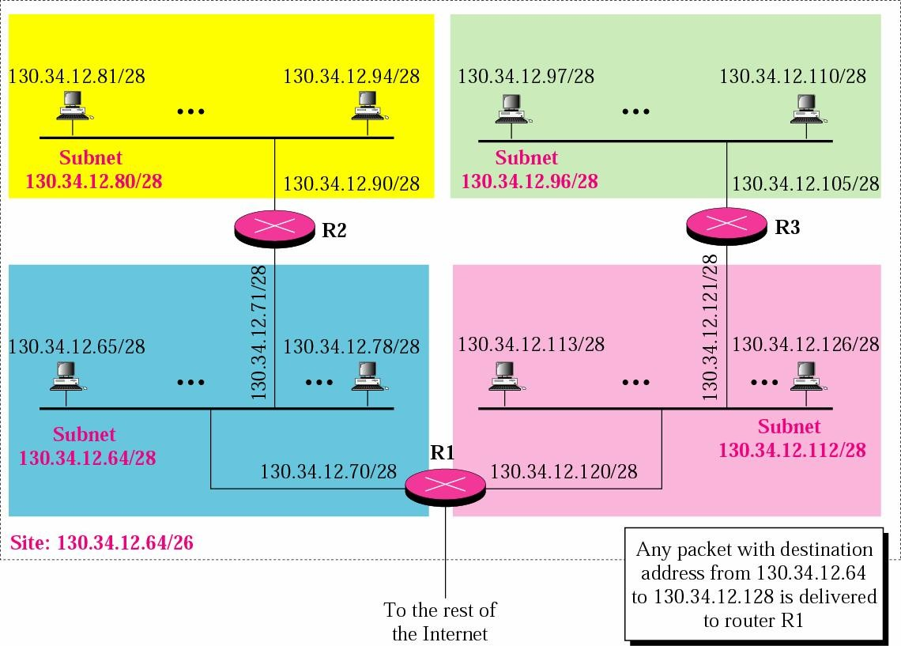
Example 13

Slide 42
Example 13 (Cont.)
The first address in the first subnet is 130.34.12.64/28
Note that the first address of the first subnet is the first address of the block.
The last address of the subnet can be found by adding 15 (16 −1) to the first address.
□ The last address is 130.34.12.79/28
The first address in the second subnet is 130.34.12.80/28
Found by adding 1 to the last address of the previous subnet.
Again adding 15 to the first address, we obtain the last address, 130.34.12.95/28.

Slide 43
Example 13 (Cont.)
Similarly, we find the first address of the third subnet to be 130.34.12.96/28 and the last to be 130.34.12.111/28
Similarly, we find the first address of the fourth subnet to be 130.34.12.112/28 and the last to be 130.34.12.127/28

Slide 44
Variable-Length Subnets
In previous examples
All of subnets have the same mask
Variable-length subnet
Design subnets of different sizes

Slide 45
Example 14
An organization is granted a block of addresses with the beginning address 14.24.74.0/24.
There are 2^(32−24)= 256 addresses in this block.
The organization needs to have 11 subnets as shown below:
two subnets, each with 64 addresses.
two subnets, each with 32 addresses.
three subnets, each with 16 addresses.
four subnets, each with 4 addresses. Design the subnets

Slide 46
Example 14: Solution
The first 128 addresses are used for the first two subnets, each with 64 addresses.
The mask for each network is /26.
The subnet address for each subnet is given in the figure
Use the next 64 addresses for the next two subnets, each with 32 addresses.
The mask for each network is /27.
The subnet address for each subnet is given in the figure.

Slide 47
Example 14: Solution (Cont.)
Use the next 48 addresses for the next three subnets, each with 16 addresses.
The mask for each network is /28.
The subnet address for each subnet is given in the figure
Use the last 16 addresses for the last four subnets, each with 4 addresses.
The mask for each network is /30.
The subnet address for each subnet is given in the figure

Slide 48
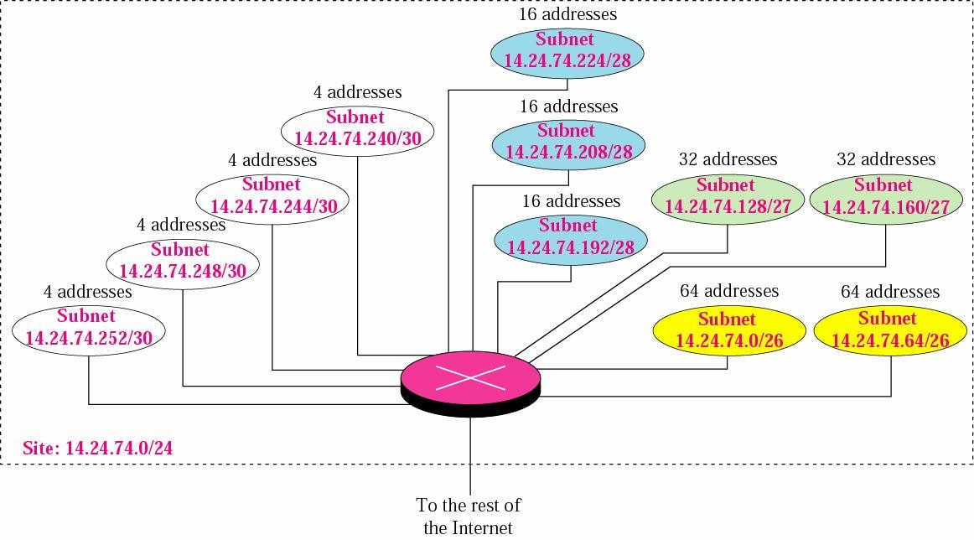
Example 14

Slide 49
Example 14: Solution (Cont.)
64
/26
/25
64
128
/26
/26
/27
/24
128
/27
/27
……
/25
/26
/27

Slide 50
Example 15
Assume a company has three offices: Central, East, and West.
The Central office is connected to the East and West offices via private, point-to-point WAN lines.
The company is granted a block of 64 addresses with the beginning address 70.12.100.128/26.
The management has decided to allocate 32 addresses for the Central office and divides the rest of addresses between the two offices.
Figure 5.8 shows the configuration designed by the management.

Slide 51
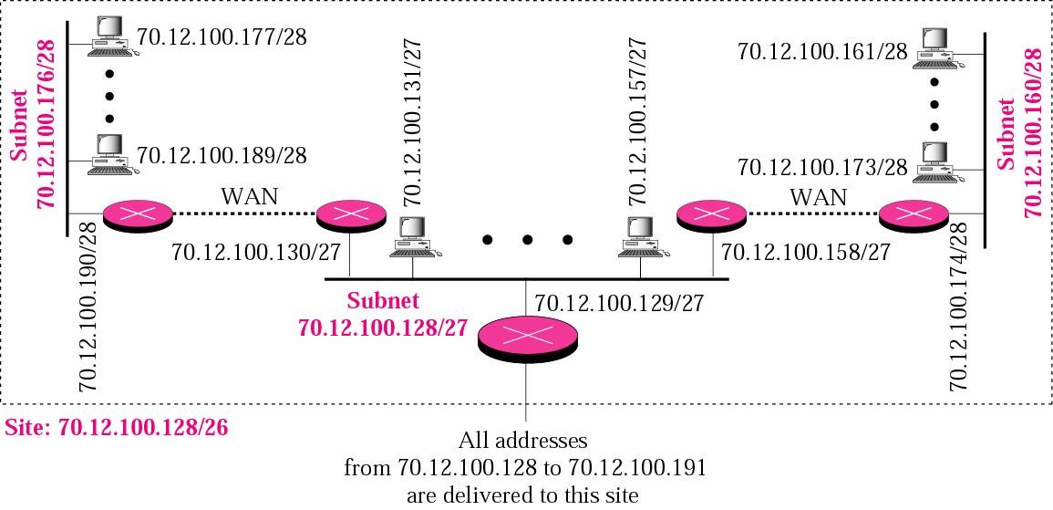
Example 15

Slide 52
Example 15: Solution
The company will have three subnets, one at Central, one at East, and one at West.
The Central office uses the network address 70.12.100.128/27.
This is the first address, and the mask /27 shows that there are 32 addresses in this network.
□ The addresses in this subnet are 70.12.100.128/27 to 70.12.100.159/27
Note that three of these addresses are used for the routers and the company has reserved the last address in the sub-block.
Note that the interface of the router that connects the Central subnet to the WAN needs no address
□ It is a point-to-point connection

Slide 53
Example 15: Solution (Cont.)
The West office uses the network address 70.12.100.160/28.
The mask /28 shows that there are only 16 addresses in this network.
The addresses in this subnet are 70.12.100.160/28 to 70.12.100.175/28.
Note that one of these addresses is used for the router and the company has reserved the last address in the sub-block.
Note also that the interface of the router that connects the West subnet to the WAN needs no address
It is a point-to- point connection

Slide 54
Example 15: Solution (Cont.)
The East office uses the network address 70.12.100.176/28.
The mask /28 shows that there are only 16 addresses in this network.
The addresses in this subnet are 70.12.100.176/28 to 70.12.100.191/28.
Note that one of these addresses is used for the router and the company has reserved the last address in the sub-block.
Note also that the interface of the router that connects the East subnet to the WAN needs no address
It is a point-to-point connection

Slide 55
5.3
Address Allocation
The McGraw-Hill Companies, Inc., 2000

Slide 56
Address Allocation
How are the blocks allocated in classless addressing?
By the Internet Corporation for Assigned Names and Addresses (ICANN)
However, ICANN does not allocate addresses to individual organization
It assigns a larger block to an ISP
Then ISP divided its assigned block into smaller subblocks to its customers
Aggress aggregation: many blocks of addresses are aggregated in one block and granted to one ISP

Slide 57
Example 16
An ISP is granted a block of addresses starting with
190.100.0.0/16. The ISP needs to distribute these
addresses to three groups of customers as follows:
The first group has 64 customers; each needs 256 addresses.
The second group has 128 customers; each needs 128 addresses.
The third group has 128 customers; each needs 64 addresses.
Design the subblocks and give the CIDR notation for each subblock. Find out how many addresses are still available after these allocations.
The McGraw-Hill Companies, Inc., 2000

Slide 58
Solution
Group 1
For this group, each customer needs 256 addresses. This means the suffix length is 8 (2⁸ = 256). The prefix length is then 32 − 8 = 24.
01: 190.100.0.0/24 €190.100.0.255/24
02: 190.100.1.0/24 €190.100.1.255/24
…………………………………..
64: 190.100.63.0/24€190.100.63.255/24
Total = 64 × 256 = 16,384
The McGraw-Hill Companies, Inc., 2000

Slide 59
Solution (Continued)
Group 2
For this group, each customer needs 128 addresses. This means the suffix length is 7 (2⁷ = 128). The prefix length is then 32 − 7 = 25. The addresses are:
001: 190.100.64.0/25 | €190.100.64.127/25
002: 190.100.64.128/25 | €190.100.64.255/25
128: 190.100.127.128/25 | €190.100.127.255/25
Total = 128 × 128 = 16,384
The McGraw-Hill Companies, Inc., 2000

Slide 60
Solution (Continued)
Group 3
For this group, each customer needs 64 addresses. This means the suffix length is 6 (2⁶ = 64). The prefix length is then 32 − 6 = 26.
001:190.100.128.0/26 | €190.100.128.63/26
002:190.100.128.64/26 | €190.100.128.127/26
…………………………
128:190.100.159.192/26 | €190.100.159.255/26
Total = 128 × 64 = 8,192 | The McGraw-Hill Companies, Inc., 2000

Slide 61
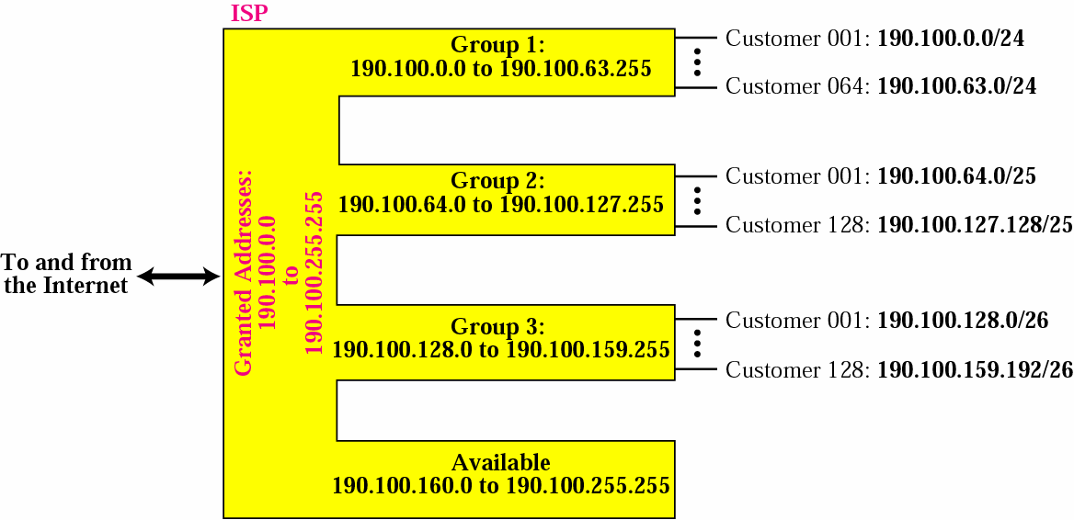
Solution (Continued)

Slide 62
Solution (Continued)
Number of granted addresses: 65,536 Number of allocated addresses: 40,960 Number of available addresses: 24,576
The McGraw-Hill Companies, Inc., 2000

